Slide 1
Introduction to CNNs
Convolution and max pooling

Slide 2




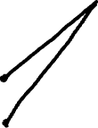












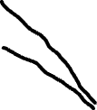








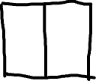








Slide 3




















Slide 4
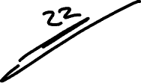










Slide 5
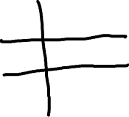



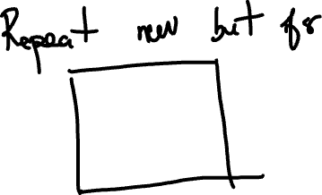








Slide 6




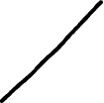















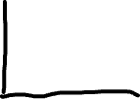



Slide 7




























General formula

Slide 8










Generalize now to 100x100 image, a dense neural network of 3 layers, each with 10 neurons
Generalize now to 200x200 image, a dense neural network of 1 layer, and a total of 40000 neurons

Slide 9


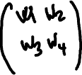




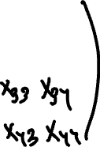













Convolution

Slide 10






























Slide 11
Count the parameters now:
Dense layer, 1 neuron, 4x4 input: 16 weight + 1 bias = 17 parameters, 1 output
CNN layer, 1 filter of 2x2: 4 weights + 1 bias = 5 parameters, 9 outputs
A convolution is like a single neuron with a small receptive field, evaluated repeatedly across the image, producing a feature map.

Slide 12
More about that example of 4x4 image
Dense neuron, sees all 16 inputs and produces 1 output
Convolutional neuron, sees local patches (2×2 at a time), and produces a feature map that contain 9 outputs.
The convolutional neuron receives 4 inputs at a time, shares the same 4 weights everywhere, and produces 9 outputs, forming a feature map.

Slide 13
Now, increase the number of kernels to 2
Repeat the same process but use another kernel, which has another weight
Now we get this:
CNN layer, 2 filters of 2x2.
Each filter produces 4 weights + 1 bias
We have 2x5 parameters and 18 (9+9) outputs

Slide 14
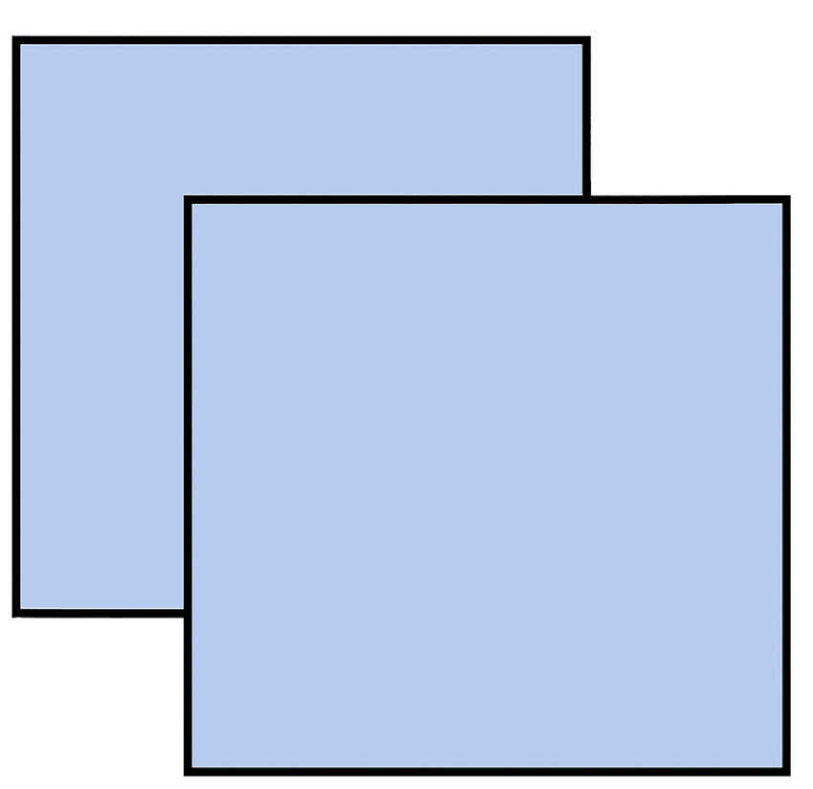
Feature maps
We have them a 4x4 image turned into two 3x3 feature maps

Slide 15
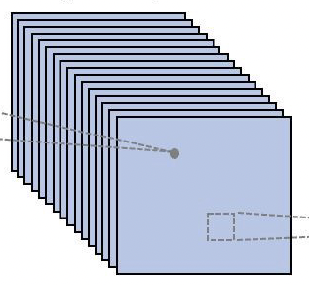
More feature maps
Use 100 kernels and you will get 100 feature maps, each 3x3
Each map shares the weights. Each map is like receptive field of 1 neuron

Slide 16
Max pooling
Max pooling is a downsampling operation used in CNNs.
It reduces spatial dimensions while keeping important features.

Slide 17





How max pooling works

Slide 18
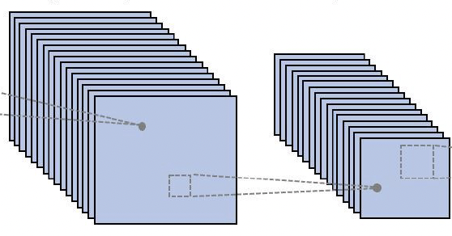


Kernel + max pooling
Main idea: with max pooling, enhance the most prominent features

Slide 19
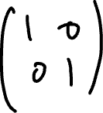









Example: convolution and max pooling

Slide 20
Padding
Padding means adding extra rows and columns around the border of an image (usually filled with zeros) before applying the convolution.
Padding allows the kernel to process border regions and prevents the output from shrinking too much.
With padding, you can preserve the original image size (“same” convolution).

Slide 21
Stride
Stride refers to how many pixels the kernel moves at each step when sliding across the image during convolution or pooling.
Stride = 1, the kernel moves one pixel at a time (produces the largest output)
Stride = 2 , the kernel jumps two pixels at a time (output becomes smaller)
Larger stride means more downsampling
(Downsampling means reducing the height and width of the feature map.)

Slide 22
Recurrent Neural Networks (RNNs)

Slide 23
What are RNNs good for? (simple explanation)
• RNNs are good at anything that unfolds over time.
• They remember what happened before while processing what comes next.
• Ideal for sequences where order matters:
Language (predict next word, translate, sentiment)
Video (predict next frame, understand actions)
Speech/audio (recognition, generation)
Time series (weather, stocks, sensors)
RNNs use the past to predict the future.

Slide 24
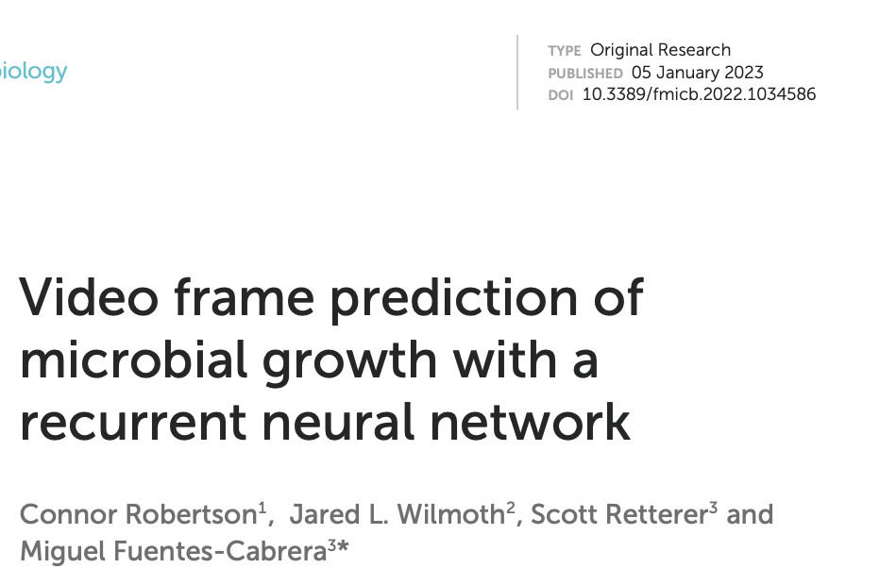
A case example from my own research

Slide 25
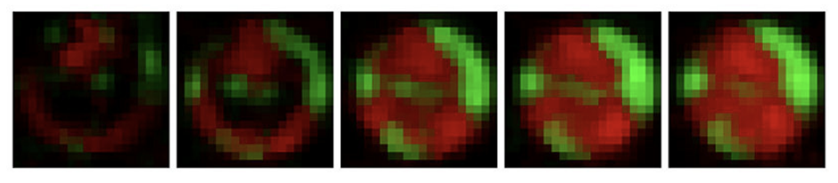
The problem: predicting video frames of growth of microbial populations
Can we do this for Recurrent Neural Networks?

Slide 26
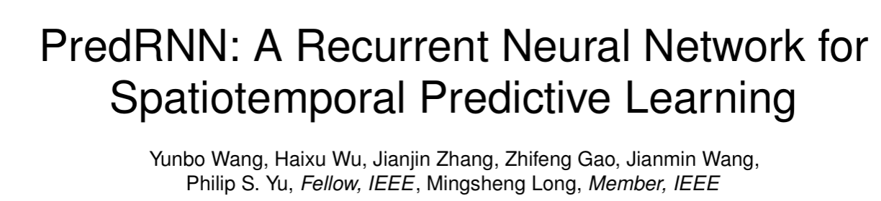
PredRNN

Slide 27
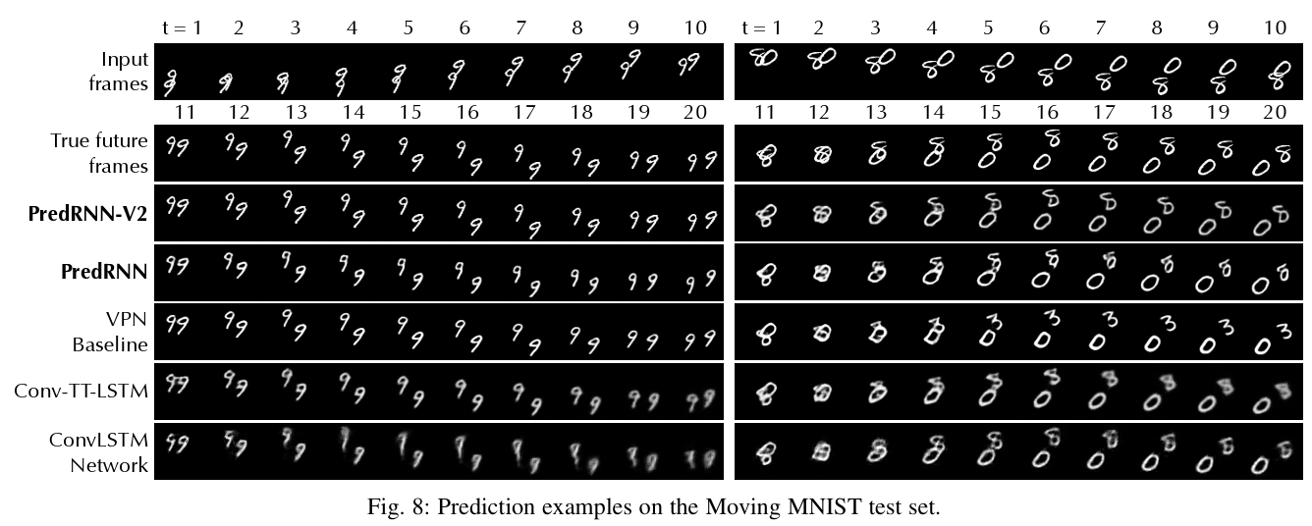
PredRNN video predictions of MNIST: comparison with other networks

Slide 28
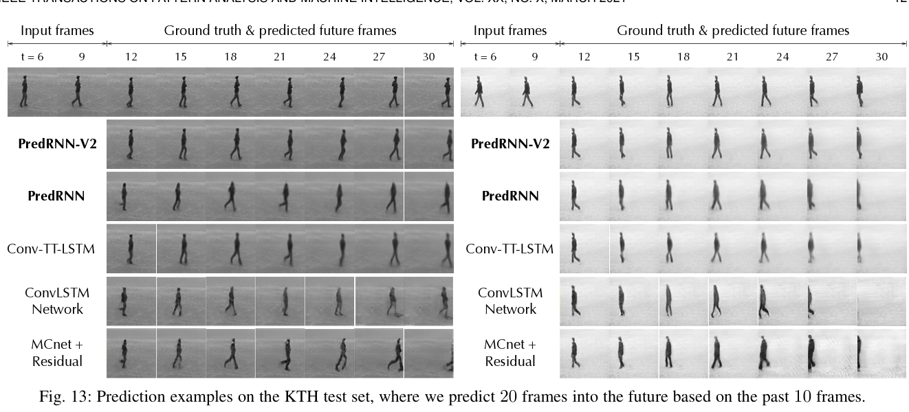
PredRNN video predictions of people walking: comparison between with networks

Slide 29
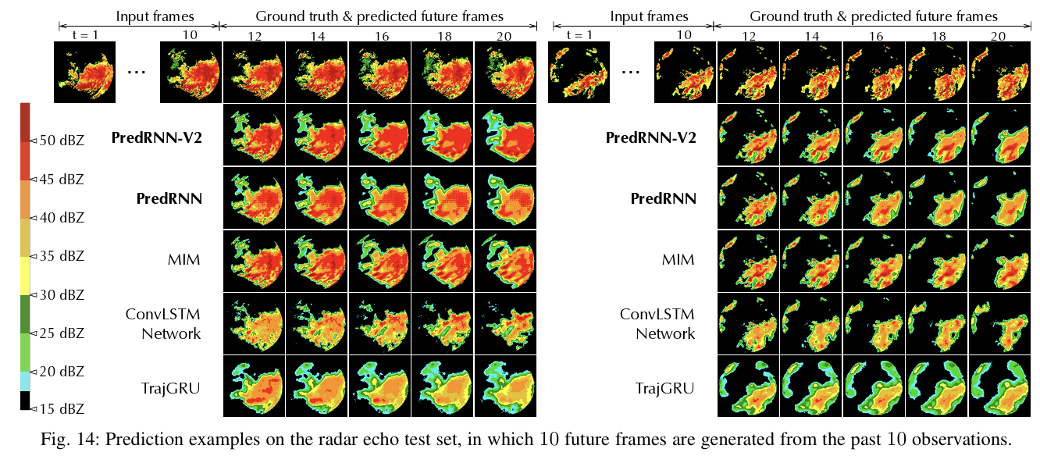
PredRNN video predictions of weather forecast: comparison between with networks

Slide 30
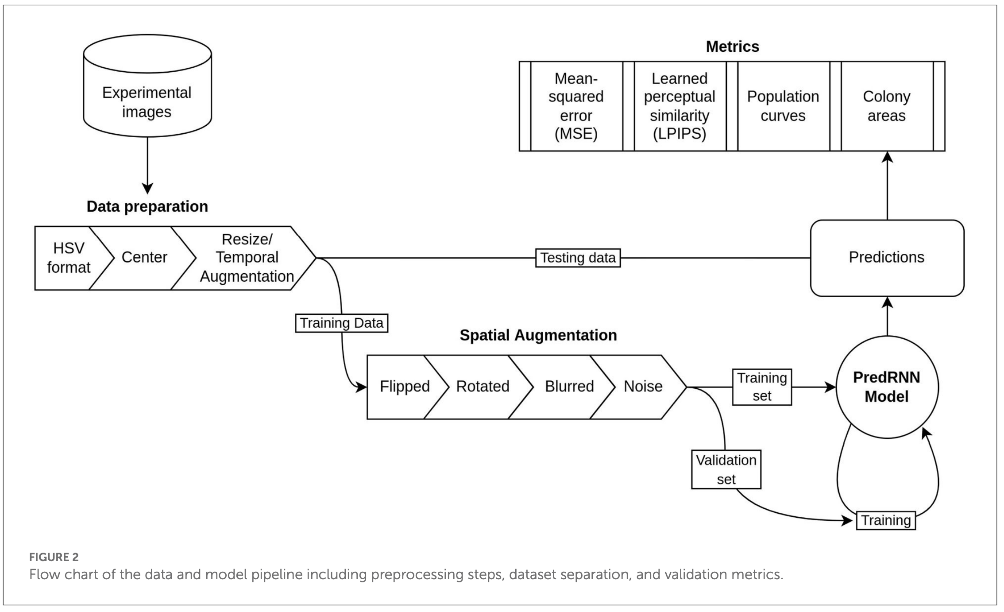
So it looks like PredRNN can work. But first, we needed to augment our data

Slide 31
Vanilla Recurrent Neural Networks (RNNs)
• It’s the simplest recurrent architecture.
• The RNN processes sequences one step at a time.
• It also shares weights across time.
• And it maintains a hidden state (like a memory).

Slide 32
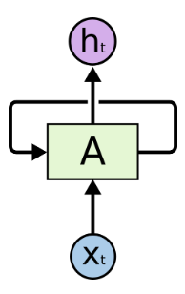
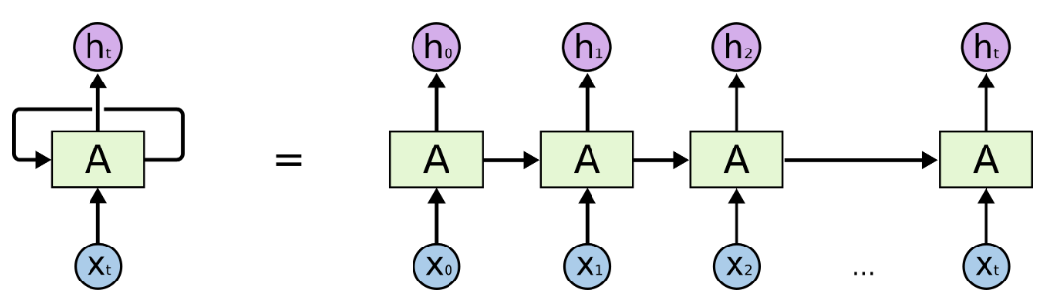
Graphical representation of RNN

Slide 33
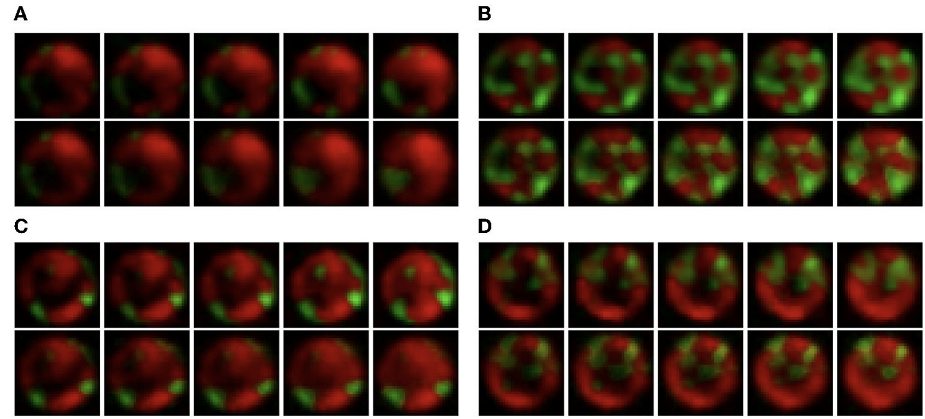
Ground truth vs. prediction: it worked, almost…

Slide 34
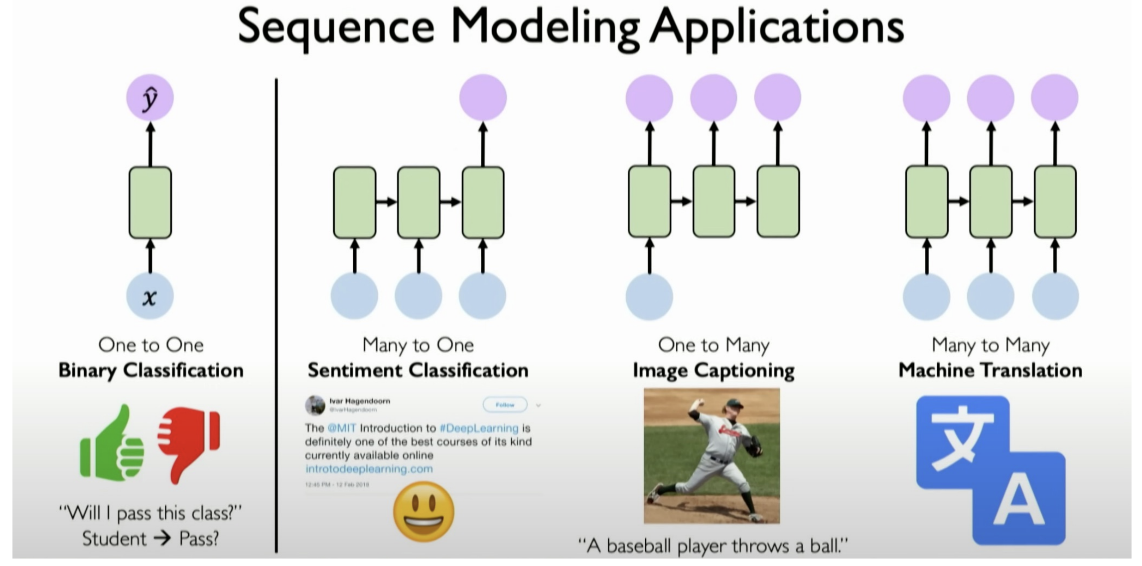
Different types of RNNs

